Slide 1
Progress Report
Basis Technology
Kratika Agrawal, Vandana Anand, Xinlu He, Min Huang, Soumya Joshi, Jing Yu

Slide 2
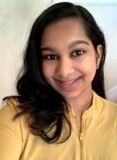
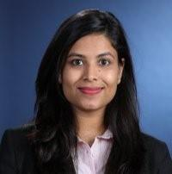
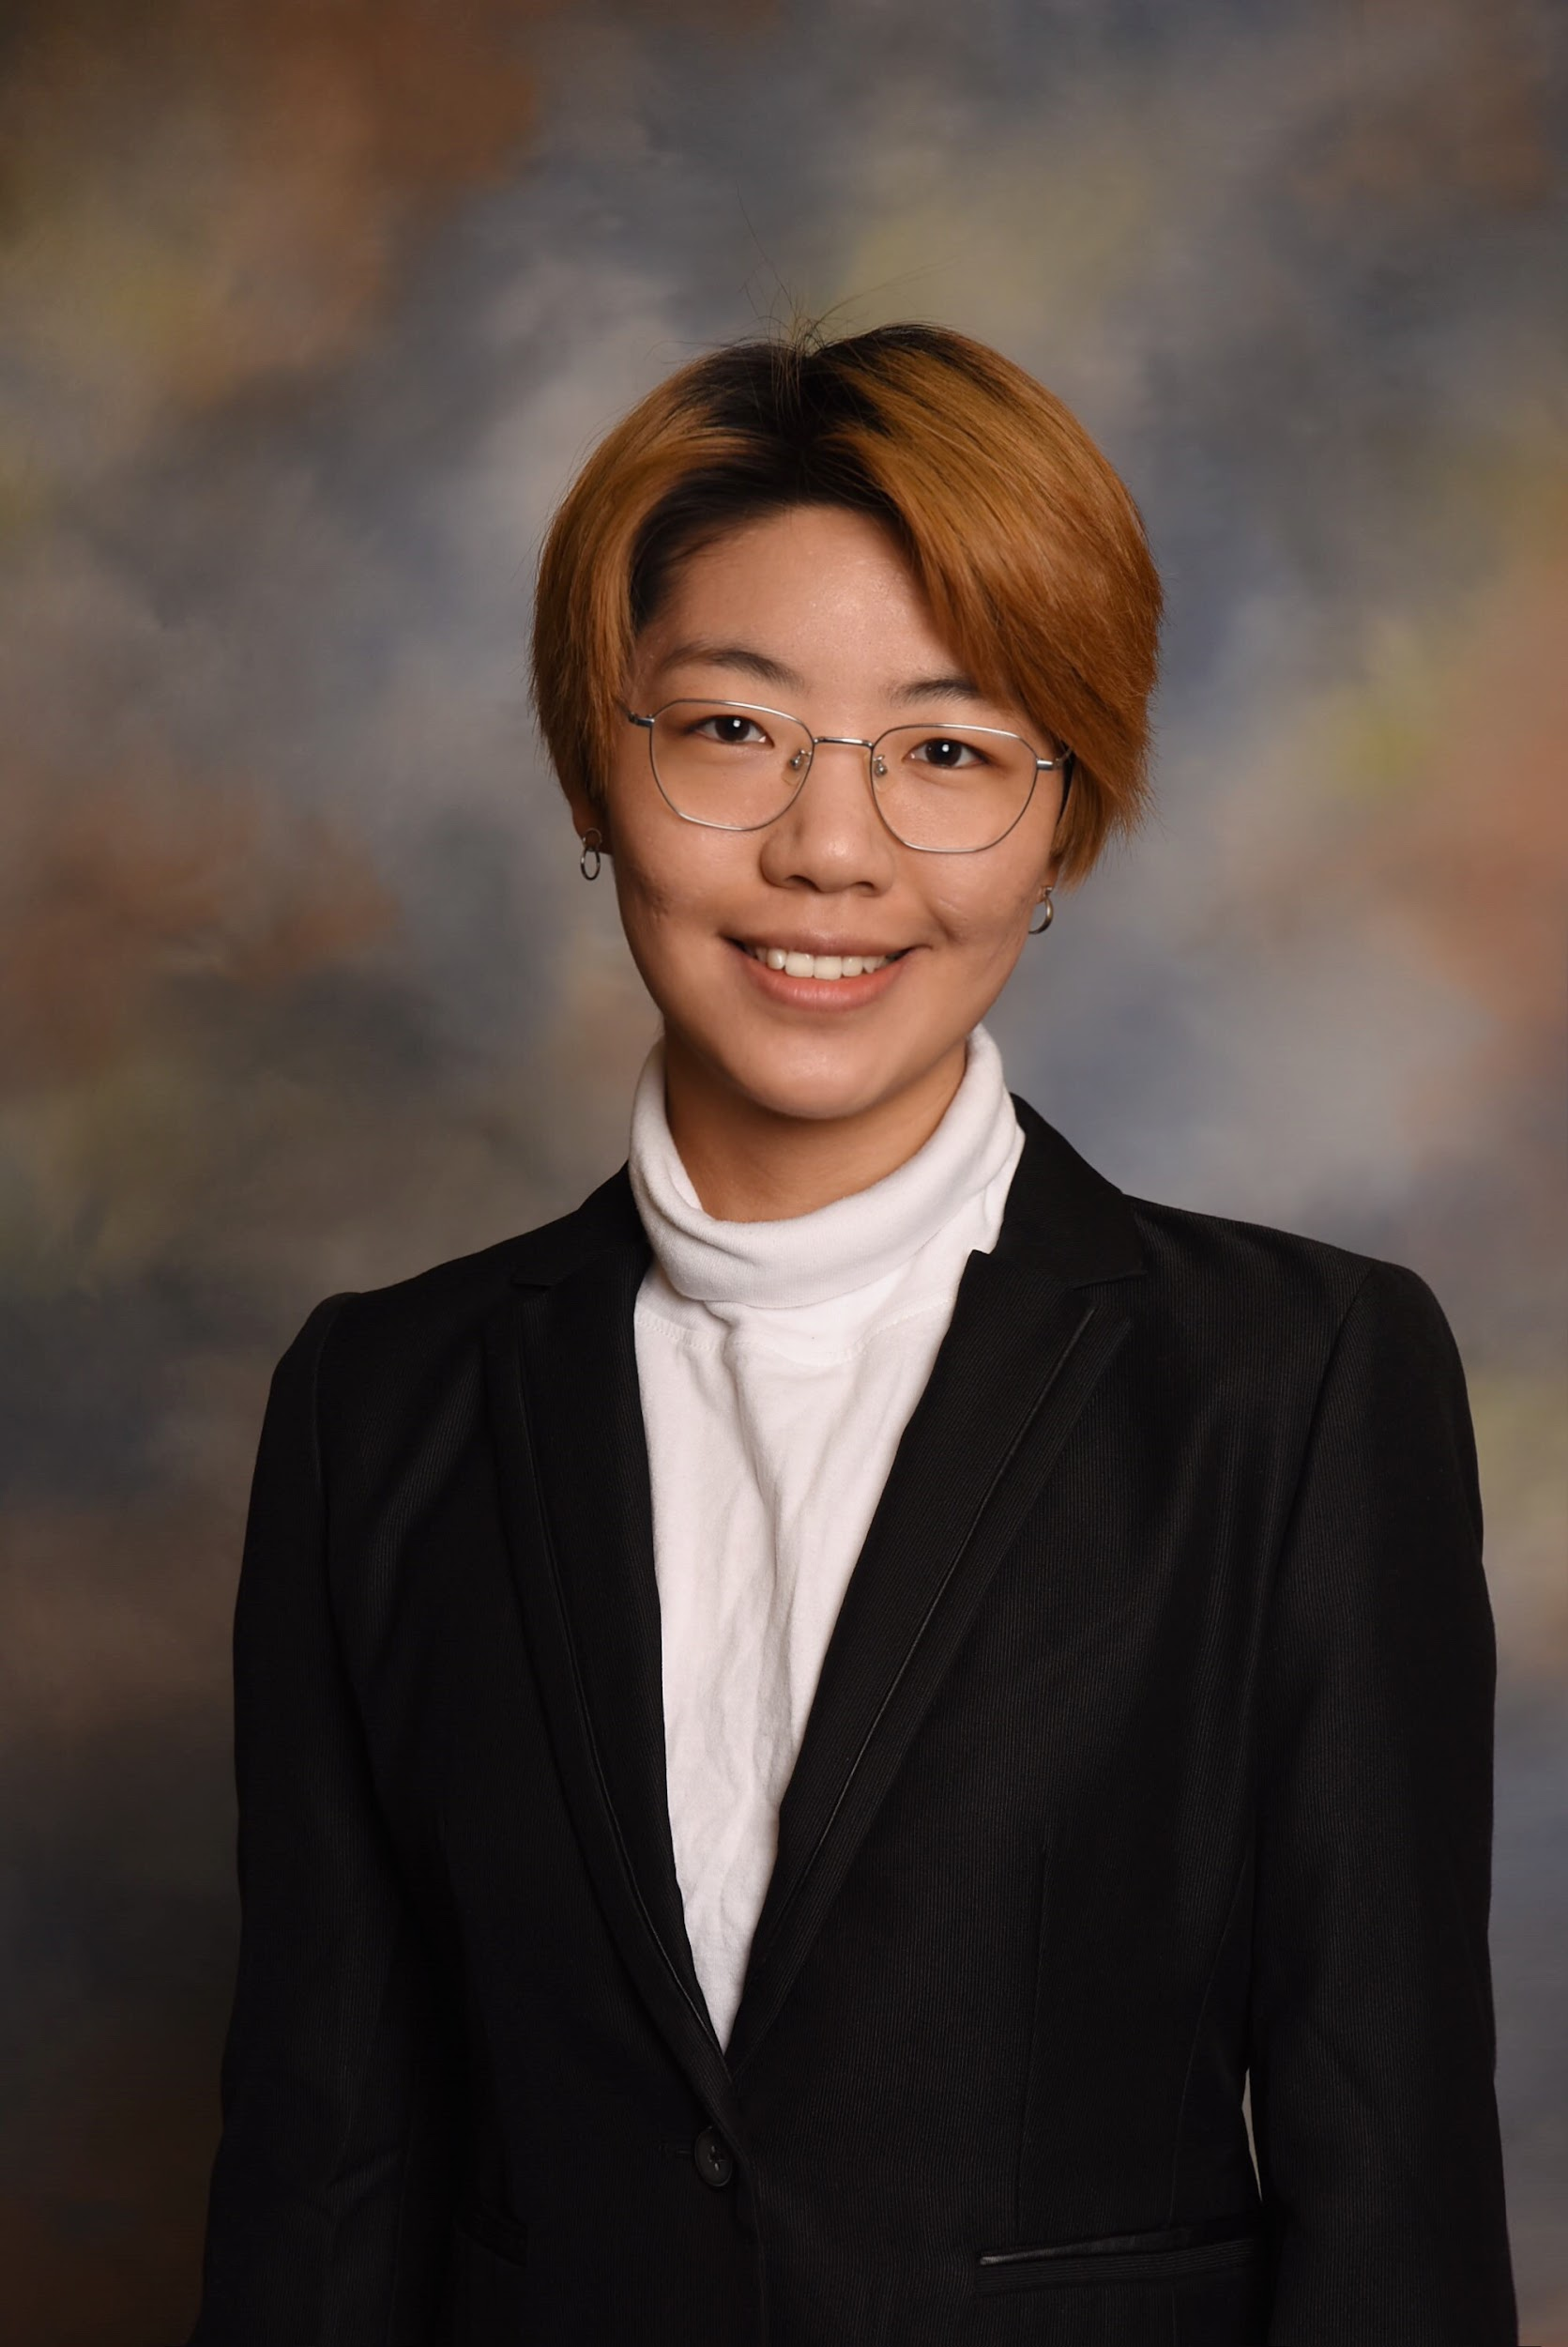



Project Team Introduction
Sponsors & Mentors
Gil Irizarry Kfir Bar
Vice President - Engineering Chief Scientist
gil@basistech.com kfir@basistech.com
Team Members
Vandana Anand vanand@wpi.edu 978-427-5212 | Kratika Agrawal kagrawal@wpi.edu 774-701-9288 | Jing Yu jyu5@wpi.edu 608-886-8578 | Soumya Joshi sjoshi2@wpi.edu 508-615-8354 | Min Huang mhuang3@wpi.edu 774-253-5410 | Xinlu He xhe4@wpi.edu 774-253-8221

Slide 3

Project Goal
Goal: Improve BT’s current entity linking tool Rosette by applying a novel model to increase entity linking performance.
Current Stage: Implement three entity linking models based on research papers.
Notes:
Rosette is a text analytics tool used to extract entities from large amounts of text, specifically nouns such as a person, place, time, etc

Slide 4
Previous weeks’ accomplishments
Data preprocessing of the AIDA dataset
Using the Entity Extraction tool provided by BT
Created a script in Java to extract entities
Querying the Wiki Database to build the candidate list using scripts to extract the information

Slide 5
Data Preprocessing
Data preprocessing
Preprocess the original AIDA dataset
Generate additional dataset based on the original one

Slide 6
Data Processing
AIDA-CoNLL dataset
TRAIN: '1 EU' to '946 SOCCER'
TESTA: '947testa CRICKET' to '1162testa Dhaka'
TESTB: '1163testb SOCCER' to '1393testb SOCCER'
Split into two files: Train.txt and TestA_TestB_Aggregate.txt
The original dataset has too many null values hence it has to be preprocessed
The dictionary data structure is used to connect context and candidate for every sentence as well as connect each mention with the equivalent sentence id as well as the wikilink

Slide 7
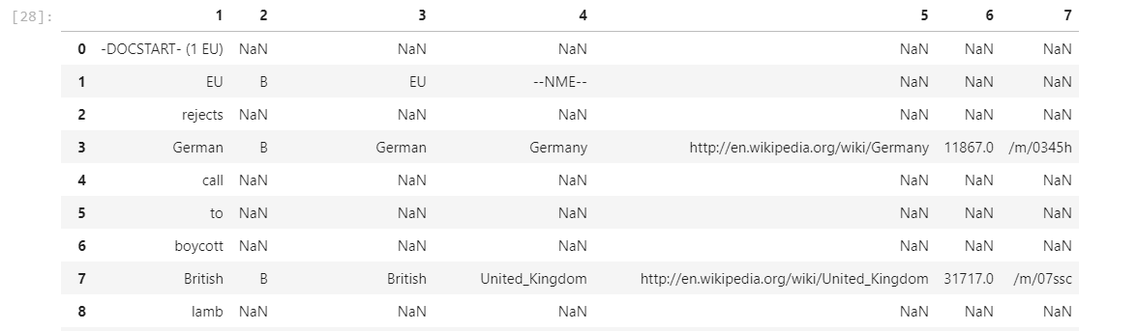
Dataset View
dict = {
'mention': mention,
'context': (lctx, rctx),
'candidates': cands,
'gold': gold}

Slide 8
New dataset
Format:-- doc_name \t doc_name \t mention \t left_ctxt \t right_ctxt \t CANDIDATES \t [ent_wikiid,p_e_m,ent_name]+ \t Gold: \t pos,ent_wikiid,p_e_m,ent_name
Candidates: the corresponding entities of the mention
ent_wikiid: the wikiID of the entity
p_e_m: Prior Possibility P(m|e) = Counts of the mention points to the entity / Total Counts
ent_name: the name of the entity
Gold: the correct entity

Slide 9
New dataset
Based on textWithAnchorsFromAllWikipedia2014Feb.txt
e.g.: ‘CSF pressure, as measured by <a href="lumbar puncture">lumbar puncture</a> (LP), is 10-18 <a href="Pressure#H2O">'
mention: lumbar puncture, entity_name = lumbar puncture
<mention,ent_wikiid> pair
Calculate frequency
For each mention, store the corresponding wikiid and frequency
Calculate the Prior Possibility P(m|e) = Counts of the mention points to the entity / Total Counts
Choose candidates with higher prior possibility(at most 100)

Slide 10
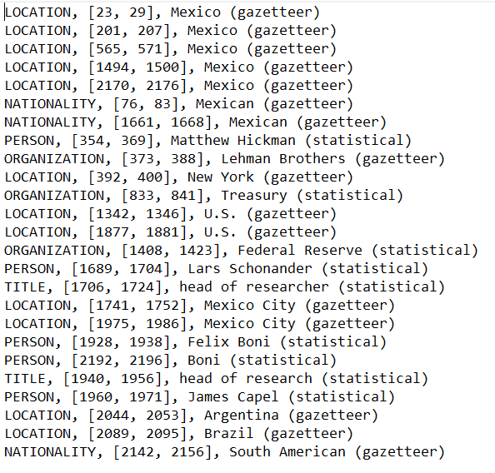
Rosette Entity Extractor (REX)
To extract entities as supported by Rosette tool
Setup Rosette Entity Extractor in local system.
Installed dependencies
Created java file to run REX
Configured build.xml for running the java file.
Sample Output on AIDA-CoNLL dataset text document:

Slide 11
Model Implementation Status
Extracting Candidate Entities Set for mentions in the AIDA-CoNLL dataset using python script.
Analyzing github code to run on public dataset instead of deeptype dataset.
Associate Type to each identified entity.
Links each entity type to Wikidata/Wikipedia record.
Entity Type: PERSON, MALE, FEMALE, ORGANIZATION, FOOD, etc.
Identify each Type as a category.
Eg: CHEMICAL_COMPOUND, DRUG, CHEMICAL_SUBSTANCE as is_chemical_compound

Slide 12
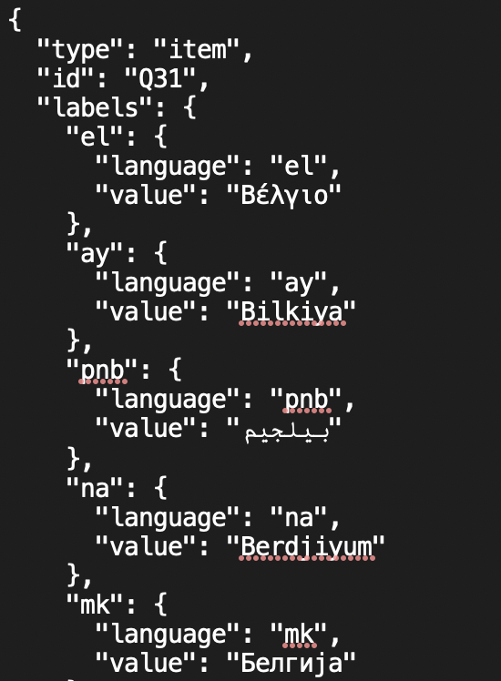
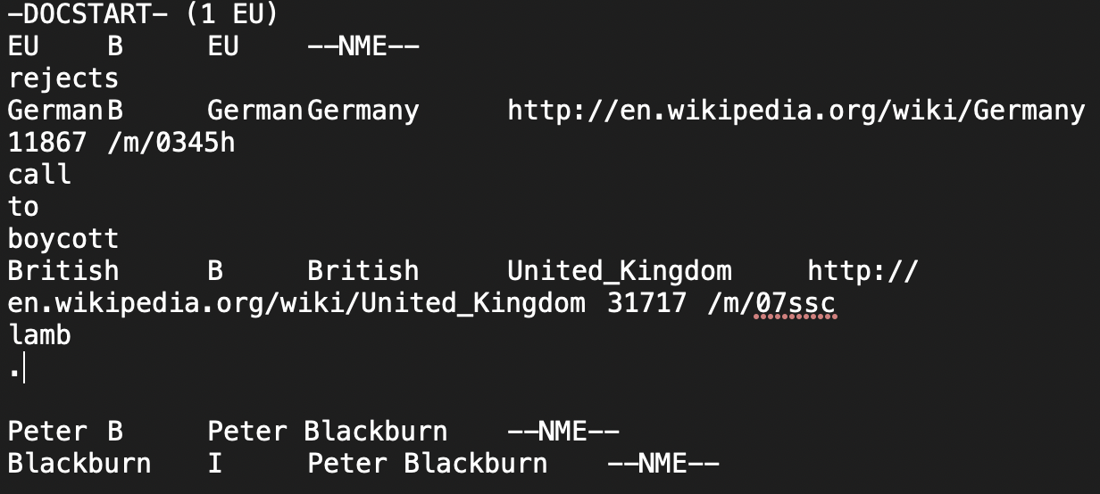
Data Reformatting

Slide 13
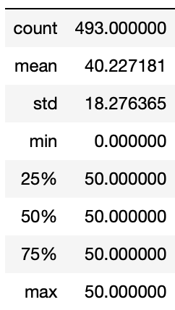
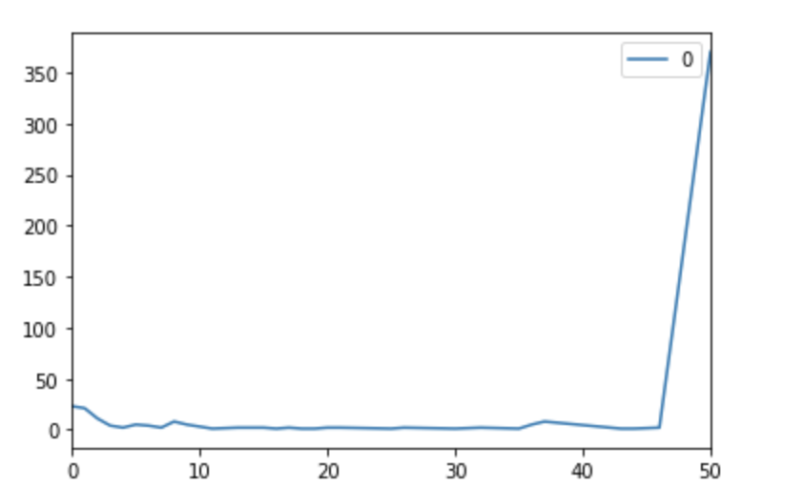
Choosing of k
The default limit is 7,changed it to 100
run wiki query through all mentions and get the size of each candidate sets

Slide 14
Difficulties
Getting access to required datasets and tools to preprocess data
Figuring out the entity extraction tool
Large datasets which takes time on training and tuning
Many null values in the dataset to take care
Dealing with entities which do not have a link to wiki KB

Slide 15
Contribution
Data preprocessing (Soumya, Vandana)
Dataset processing (Min)
Working with Rosette Entity Extractor Tool (Kratika)
Wikidata querying (Xinlu)
Analyzing the choice of k (Jing)

Slide 16
Plans
Implement the three models from research papers
End to End
Deep Type
Latent
Evaluate the model performance
Determine the best model to improve BT’s process

Slide 17
Thank you!

